Slide 1
The Pram Safety System
Group 2: Design Report
Jo Oughton, Peter Deeks, Tom Kerfoot,
Colin Smith, Darren Baker, Marc Wylie

Slide 2
Concept Design Approach shown with respect to the V Diagram Lifecycle
System verification (including completion of safety case)
Requirement
Capture (including safety requirements)
Functional Decomposition Analysis
Functional Hazard Assessment
Concept Development
HAZOP/ Preliminary Hazard Analysis
Further Development and completion of Safety case
Development of Safety case
Hazard Identification
Concept refinement
Safety Requirement Specification (including Safety Integrity levels)
Safety verification
(testing)
Detailed Technical specification
Start of detailed design
Final design and manufacture

Slide 3
Requirements
11 CRS
Customer Specification |  | Engineering Requirements
1 | Easy to Use | No tools required to use Ergonomic compatibility in accordance with international standards (HSG) Force of operation to be less than 1.5Nm Allow single handed operation
2 | Easily fitted by parent with minimal engineering know-how | No tools required to install (poke yoke) Pictorial installation instruction (multi-language) No more than three component parts (No individual ‘small parts’ – No parts with a diameter greater than 31.7mm (CPSC standard) Adjustable fittings
3 | Usable on a diverse range of brands/models | Generic design Compatible with prams built to BS EN 1888:2003 Adjustable fittings
4 | Non-interfering to normal use/functions of the pram | Size Doesn’t adversely effect C of G Allow folding No trap hazard Doesn’t affect manoeuvrability Allow single handed operation

Slide 4
Requirements
Customer Specification |  | Engineering Requirements
5 | Minimal / No Maintenance | No lubricated parts
6 | Light-weight | Weight to be less than 0.5Kg
7 | Durable and Reliable | Failure rate on demand 1 x10⁻⁶
8 | Weather resistant | Construction materials to be corrosion resistant Operational temp range -5degC to +40degC
9 | Neutral design (Attractive in appearance) | Available in a range of colours and finishes
10 | Inexpensive | £20 to produce (20% of Pram RRP – Average £50 per unit)
11 | Passive Operation | Design must not require user interaction to activate

Slide 5
Functional Decomposition
Emergency Brake
Standby
Standby
Brake Activated
Energy
User Regulated K.E.
Unregulated
K.E.
Energy Absorbed
Zero K.E.
Pram Stops
Trip /
Activation
Monitoring
Senses Change
Sends Signal to Brake

Slide 6
Functional Hazard Analysis
Functions broken down into blocks
In / Out of Standby
Sensing / triggering
Emergency Device
Kinetic Energy Absorption
Each Block analysed against four failure modes in respect of Effect and Severity
Following slide shows table for Emergency Device

Slide 7
Functional hazard assessment
FAIL MODE | EFFECT | SEVERITY
LOSS OF FUNCTION | No ability to detect loss of control device fails to operate Pram Fails to stop | Major / Catastrophic
SPURIOUS OPERATION | Activation of device when not required causing pram to stop in normal use | Minor Safety Pram operation inhibited
INCORRECT OPERATION | 1. Device not operated pram fails to stop 2. See spurious operation | Major / Catastrophic Minor Safety / Pram operation inhibited
DELAYED OPERATION | Pram continues into potential danger Build up of KE causes overturn as a result of eventual braking | Major / Catastrophic Major / Catastrophic

Slide 8
Functional Hazard Analysis
Conclusions drawn form each table regarding functional block
These conclusions further defined Engineering Requirements
Conclusions determined high reliability was key
Over braking was less of a hazard than under braking
Sensing system to be fail safe
Degradation due to wear not acceptable

Slide 9
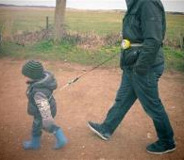
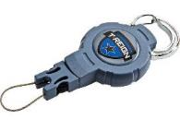
“Our Preliminary Concept”
High reliability vs cost means simplicity of design
Not to interfere with standard pram brake (Warranty)
Low cost rules out complex mechanical or electrical solutions

Slide 10
2
1
5
4
3
 | Component | Function
1 | One wrist strap | Strap secures lanyard to parent wrist
2 | Two clamps | Clamps secure lanyard to pram
3 | Lanyards | Lanyard connect pram to parent
4 | Retracting mechanism | Retracts lanyard when not attached to parent
5 | Stowage for wrist strap | Secures lanyards to pram when not in use

Slide 11
HAZOP
Function | Guideword | Deviation | Cause | Consequence | Action / Mitigation | Severity
Strap secures lanyard to the parent | None | Strap not secured to parent | Parent choice | Pram doesn’t stop | Instructions and bright colours Structural test Material Choice | High
 |  |  | Strap failure | Pram doesn’t stop
 |  |  | Parent forgets | Pram doesn’t stop
 |  |  | Incorrect attachment | Pram doesn’t stop
 | More of | Strap to long | Design incorrect height incompatability | Trip hazard | consider pram operator | Medium
 |  |  |  | Retardation not applied in time | inc. suitable retractor | high
 |  | attachment too secure | Design error lack of operating instructions | Single handed operation not possible | consider pram operator | Low
 |  | retraction to powerful/quick rebound | Design error | injury to parent / damage to property | consider in design | Medium injury sustained to parent child
 | Less of | Strap not long enough | Design incorrect height incompatability | impair ability to use | operator instructions | Low
 |  | Attachment not secure enough | operator error | Pram doesn’t stop & injury to person | fool-proof operator instructions | High
 |  |  | Component failure | pram doesn’t stop & injury to person | Design | high
 |  | retraction to slow | Design error | Trip hazard | Design | Medium
 |  |  | Component failure over-stretch | Retardation not applied in time | Stop stretch | High
 |  | Strap not strong enough | Bad design | strap snaps & pram doesn’t stop | Design | High
 |  |  | Material failure | strap snaps & pram doesn’t stop | Design | High
 |  |  | Weight limit exceeded . | strap snaps & pram doesn’t stop | operator instructions | High
 | Part of | Stops eccentrically | incorrect installation | Pram loses stability | Considered in design | High
 |  |  | Design error |  | operator instructions
 |  |  | Component failure
 |  | Wrist attachement doesn’t fit
Clamps which secure to the pram | More of | Clamp affects structural integrity of pram | excessive clamping | Pram doesn’t stop | Structural analysis of pram | High
 |  |  | excessive strain | Pram collapses in normal operation
Secures lanyard to the pram when not in use | None | Not stowed | stowage point fails or not used correctly | Strangulation trip hazard | Suitable storage | High Medium
 |  | Loss of component containment | Small Parts come free | Choke on small parts | Design to consider breakage | High / Medium
 |  |  |  | Trip hazard | Wear and tear to be taken into account
 |  |  |  | Sharp edges
HAZOP facilitates the generation of a preliminary hazard list…

Slide 12
Initial Hazards Identified from HAZOP
Hazards | Initial Unmitigated Risk
Description | Severity | likelihood | Cause | Control
Pram doesn’t stop | High | High | 1) Strap or clamps or lanyard fail 2) parent forgets to fit 3) incorrect attachment 4) structural damage to pram from clamping mechanisms | See HAZOP
Trip Hazard | Medium | High | 1) Retraction of Lanyard too slow 2) Strap too long 3) Lanyard stowage failure | See HAZOP
Injury to Pram operator | High | High | 1) retraction of lanyard too fast | See HAZOP
Injury to Pram occupant | High | Medium | 1) Lanyard clamps cause structural damage to pram leading to failure | See HAZOP
Damage to Property | Low | Low | 1) Trip hazard | See HAZOP
Injury to 3rd parties | High | Medium | 1) Trip hazard | See HAZOP
These Initial hazards will form the basis of a hazard log, causes controls evidence will be updated as the design matures.

Slide 13
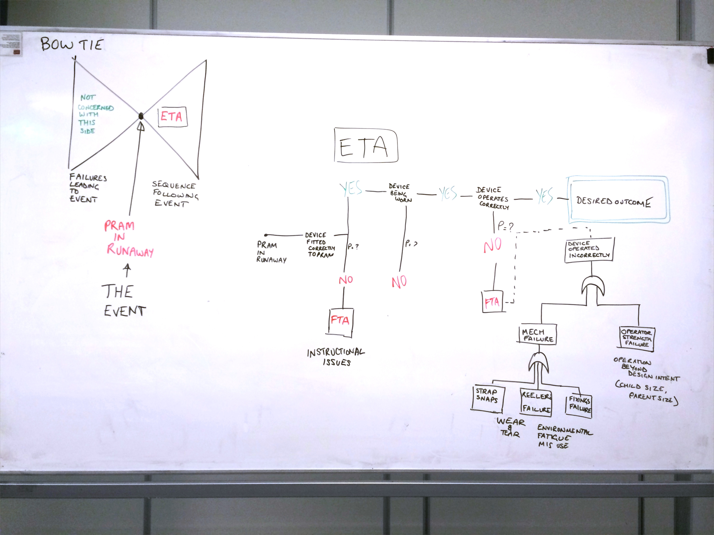
Bow Tie and ETA / FTA

Slide 14
ETA / FTA
Pram Stops

Slide 15
The Safety Case
Context
Risks to parent and child
Compliance argument
Process/technical argument
Assurance
General structure
Defined, implemented and maintained
Context
Acceptable level
IAW safety target XYZ
Top Goal
Risks associated with the pram brake are managed to an acceptable level
Context
Associated with the pram - Design does not affect the safety of pram’s original design (excludes the prams SC)
Strategy
Argument over
all applicable standards are defined, satisfied implemented and compliance with safety management principles
Notes:
Other considerations
Changes ??
Safety target??
Confidence/assurance deficit??
Independent assurance
Design/Safety documentation??
Maintenance
References
Rather basic but can go a further if agreed or as it evolves.
Goal 1
Risks are identified and mitigated
Goal 2
All applicable standards are satisfied and implemented
Goal 1.1
Risks are identified
Goal 1.2
Risks are mitigated
Goal 2.1
Design solution meets requirements through testing and verification
Goal 2.2
Design solution meets
standards
XYZ
Goal 2.3
User manual ensures instructions for correct assembly and general limitations are made available
Solution
HAZOP
FMECA
FTA
ETA
Solution
Hazard log
Solution
Test and verification results evidence
Solution
CSR
ER
SR
Solution
User manual

Slide 16
Next Steps
Technical Specification confirmed inc. SIL assessment
Safety Requirements Specification confirmed inc. CE marking.
Detailed Concept Design Phase
Structural design on 10 major pram types
Design for Manufacture
Manufacture
Test and Verification
Product
Complete System
Safety Case Maintenance
Future Project Expansion for Further Pram Types

